Slide 1
Car Price Prediction
CAPSTONE PROJECT
Presented By: Collage:
Prateek Kumawat University of Kota

Slide 2
OUTLINE
Problem Statement
Proposed System/Solution
System Development Approach (Technology Used)
Result
Conclusion
Future Scope
References

Slide 3
Problem Statement
Objective: Predicting car prices accurately is crucial for buyers and sellers in the automotive market. Traditional methods are often inaccurate and time-consuming.
Challenges:
Large and complex datasets
Need for accurate feature selection
Integration of multiple data sources
Achieving High Accuracy

Slide 4
Proposed Solution
Machine Learning Model: Develop a predictive model using machine learning algorithms to estimate car prices based on various features.
Data Collection: Gather data on car features such as make, model, year, mileage, engine size, fuel type, and more.
Feature Engineering: Process and select relevant features that influence car prices.
Model Training: Train and evaluate different machine learning models to find the best-performing one.

Slide 5
System Approach
System Requirements:
Windows 10, 8GB RAM, Intel i5 Processor
Libraries and Tools:
Python
Pandas, NumPy
Scikit-learn, Pickle
Matplotlib, Seaborn
Jupyter Notebook

Slide 6
Data Collection and Preprocessing
Data Sources:
Online car databases ( Kaggle ).
Pre-processing Steps:
Data Cleaning: Handling missing values, outliers, and duplicates.
Feature Selection: Choosing relevant features for the model.
Encoding: Converting categorical variables into numerical format.

Slide 7
Model Training and Evaluation
Algorithms Used:
Linear Regression
Decision Trees
Random Forest
Gradient Boosting
Evaluation Metrics :
Mean Absolute Error (MAE)
Mean Squared Error (MSE)
R-squared (R²) score
Prediction score
Model Selection: Comparing models based on performance metrics and selecting the best one.

Slide 8
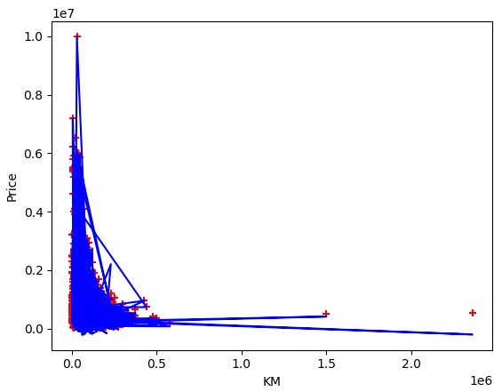
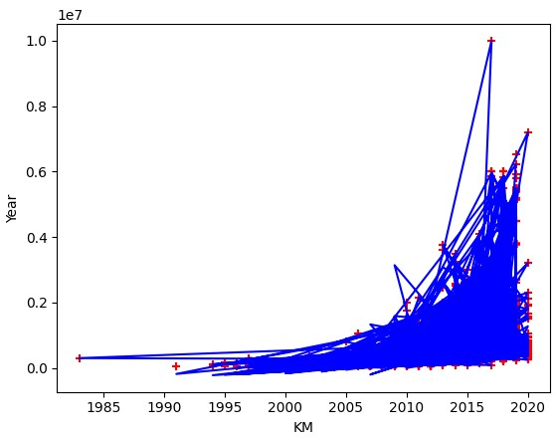
Result
Best Model:
Linear Regression
Performance:
Prediction Achieving Accuracy : 98.85%

Slide 9
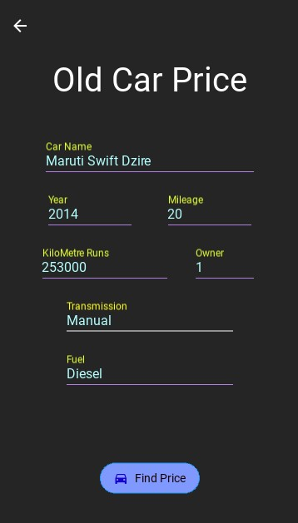
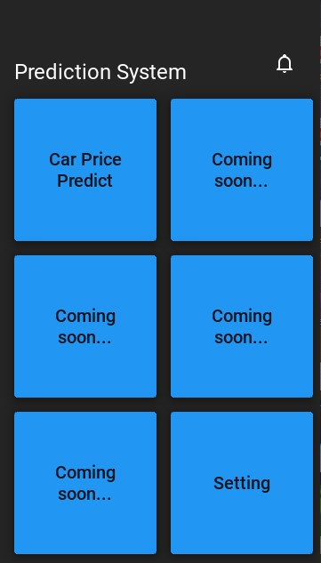
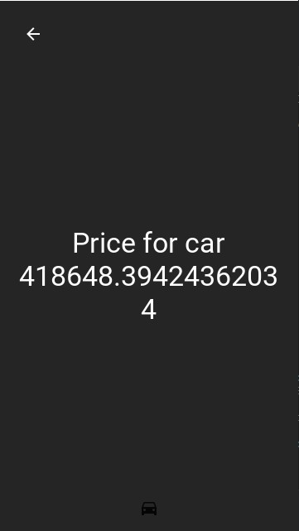
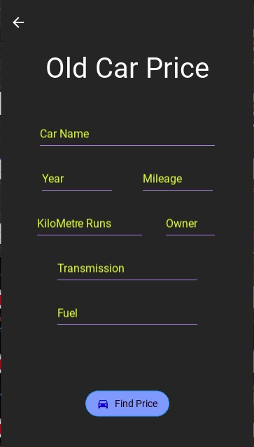
Result

Slide 10
Conclusion
Summary: The machine learning model developed provides accurate car price predictions based on the given features, outperforming traditional methods.
Impact: This solution can help buyers and sellers make informed decisions, improving market efficiency.

Slide 11
Future scope
Enhancements:
Incorporate more features and larger datasets to improve accuracy.
Use advanced algorithms like neural networks.
Develop a user-friendly interface for non-technical users.
Additional Applications: Extend the model to other types of vehicles or integrate with dealership management systems.

Slide 12
References
IBM Cloud : https://cloud.ibm.com/login
Kaggle : https://www.kaggle.com/
IBM Skills Build : https://skillsbuild.org/

Slide 13
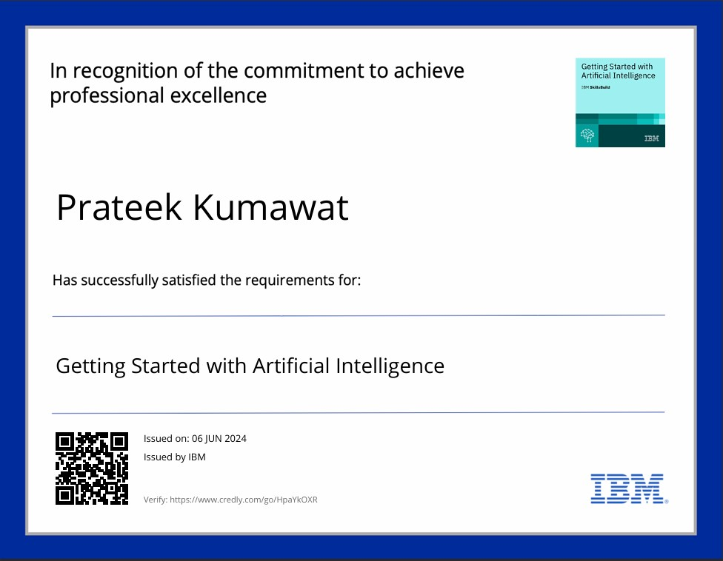
course certificate 1

Slide 14
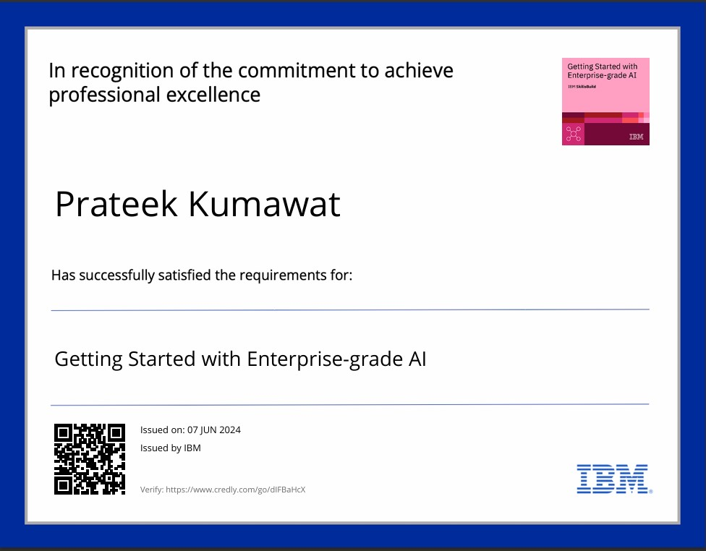
course certificate 2

Slide 15
THANK YOU

